Slide 1
Statistics For Data Science
DTSC 620 Fall 2022
Instructor
Kiran Balagani, Ph.D.
kbalagan@nyit.edu
Teaching Assistant
Mr. Pranadeep Potti (mpotti@nyit.edu)

Slide 2
Agenda
Previous Lecture
ROC Analysis
Project Assignment #1 Demo
Base Rate Fallacy
Today’s Lecture
Midterm Details
Introduction to Decision Tree Paper/Worksheet

Slide 3
Important Dates and Deadlines
Midterm Exam (Oct. 24th, class time)
Final Exam (December 19th, class time)
Project Assignment 1 (31 October 2022)
Project Assignment 2 (~3rd week of Nov.)
Project Assignment 3 (~2nd week of Dec.)
Additional homework, opinion papers, presentations will be announced

Slide 4
Midterm Details Slides Posted on Canvas under ‘Midterm Exam Details’ folder

Slide 5
Previous Lecture

Slide 6
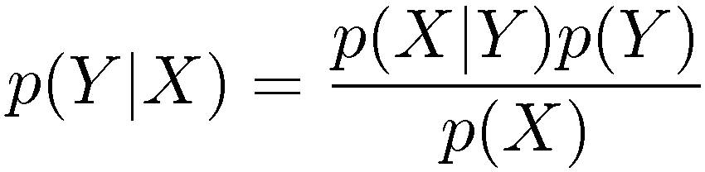
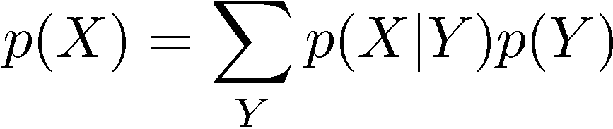
Bayes’ Theorem
posterior ∝ likelihood × prior

Slide 7
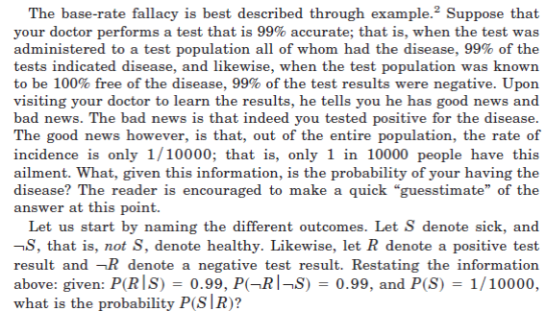

Slide 8


Slide 9
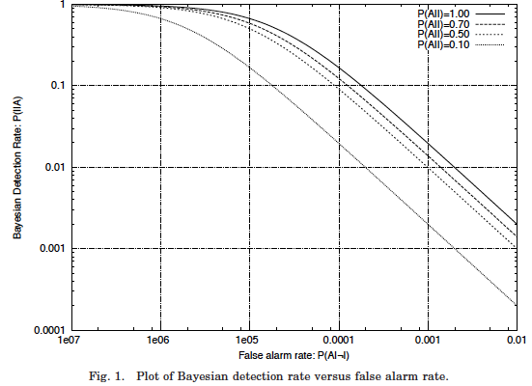

Slide 10
Today’s Lecture

Slide 11
Decision Trees

Slide 12
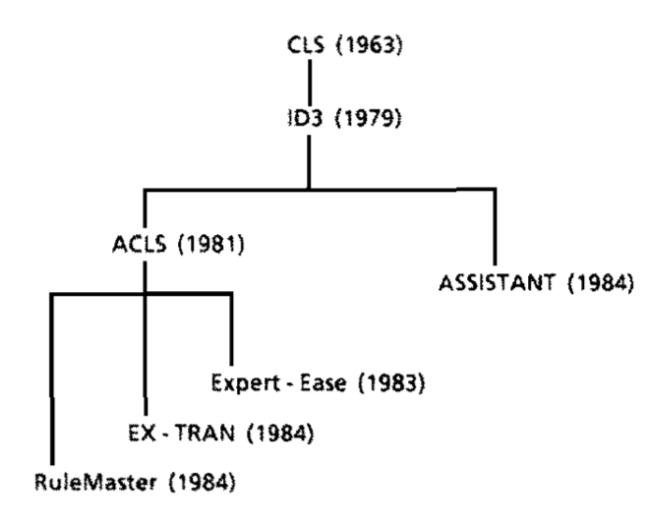
TDIDT Family Tree

Slide 13
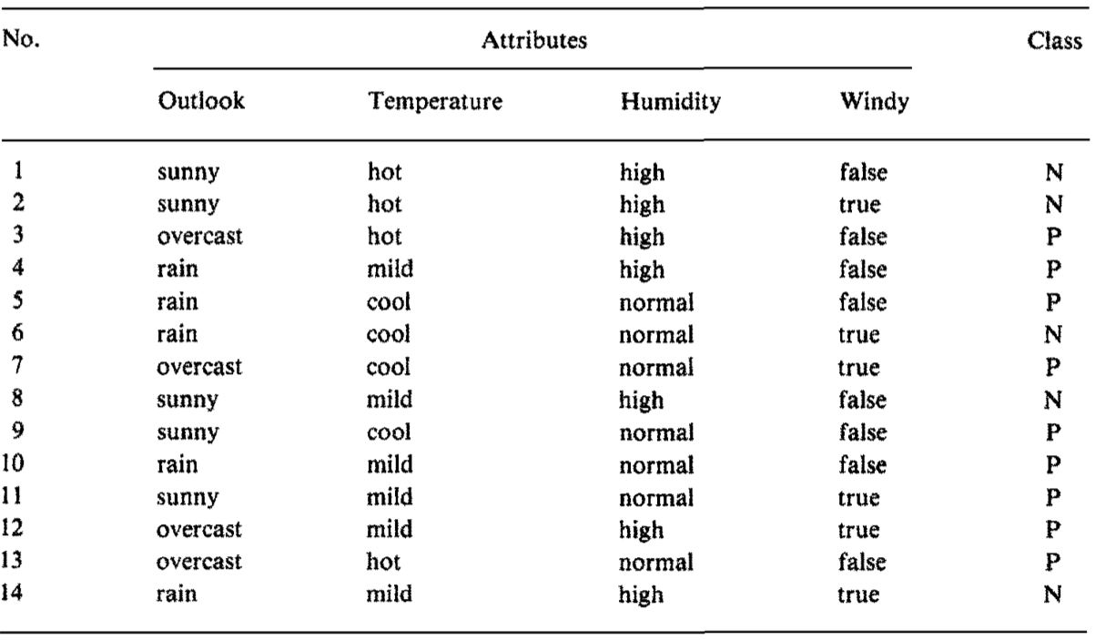
Training Set

Slide 14
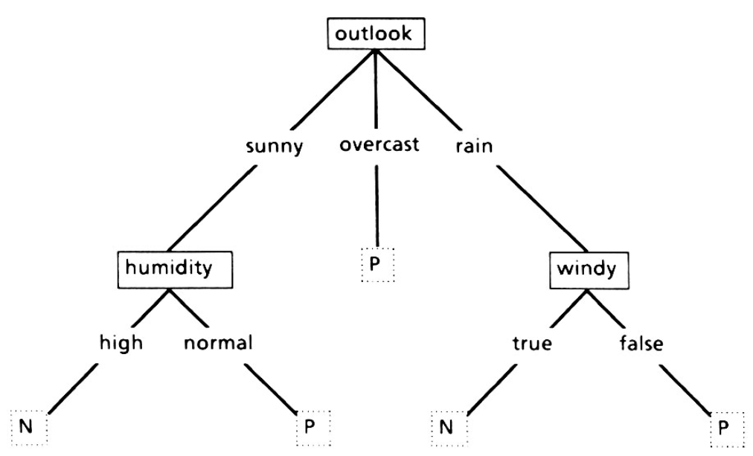
Simple Decision Tree

Slide 15
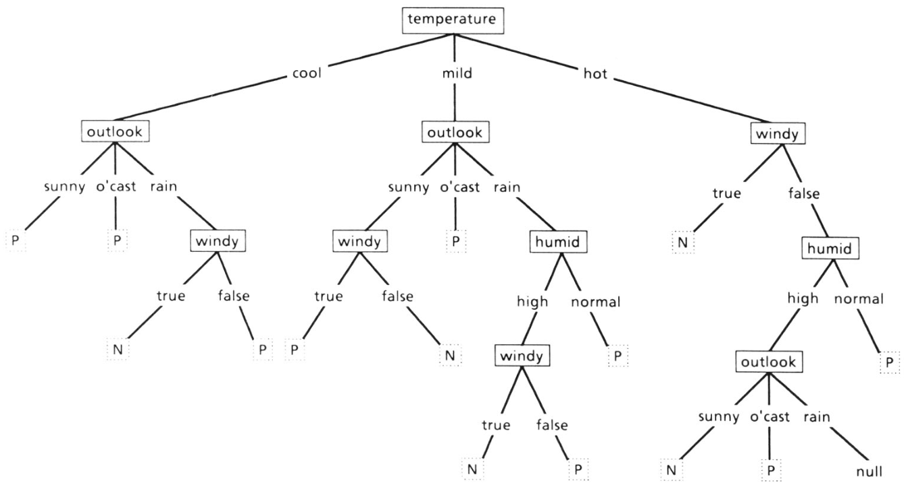
Complex Decision Tree

Slide 16
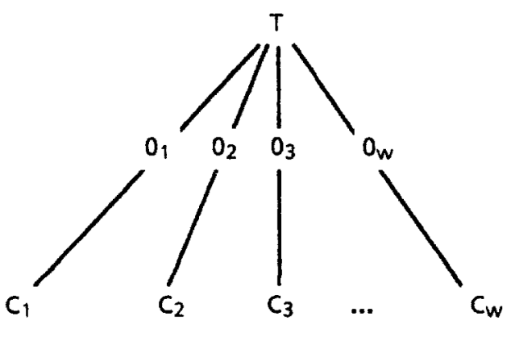
Tree Structuring of Objects

Slide 17
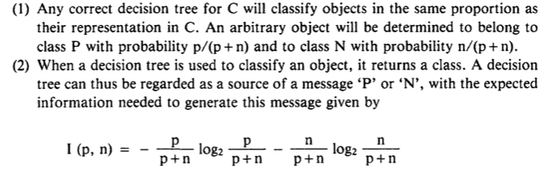
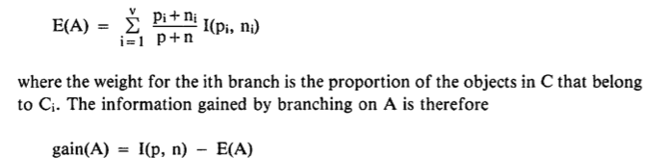
ID3 Information-Based Method
The expected information required for tree with A as root is the obtained as the weighted average:

Slide 18
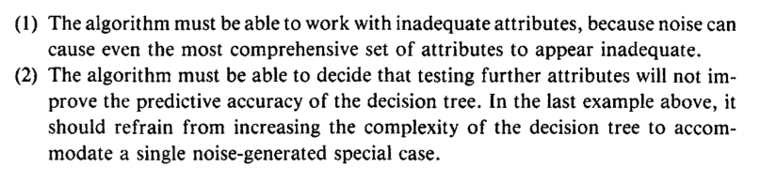
Noise
Requirements to operate with noise-affected training set

Slide 19



Slide 20
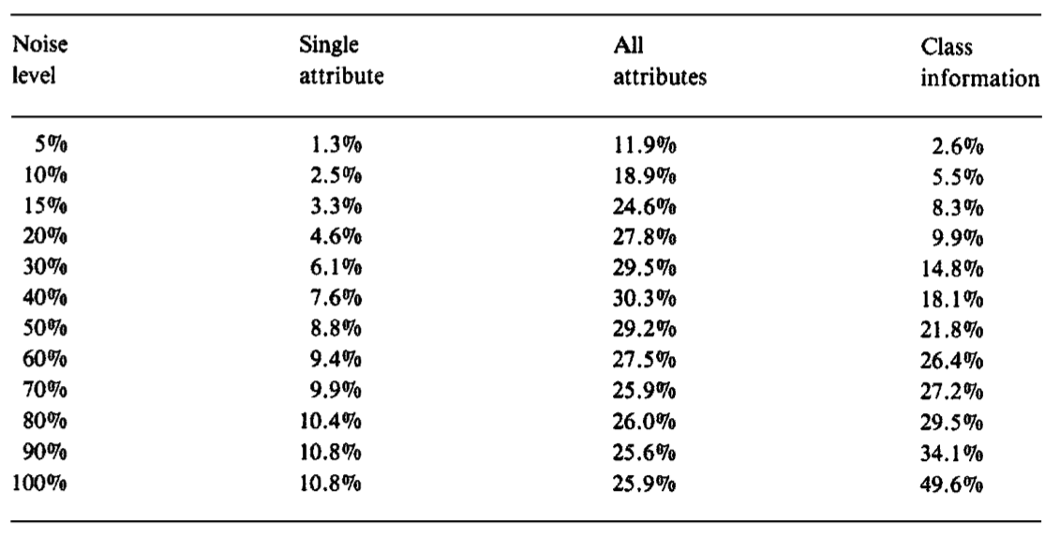
Error Rates

Slide 21
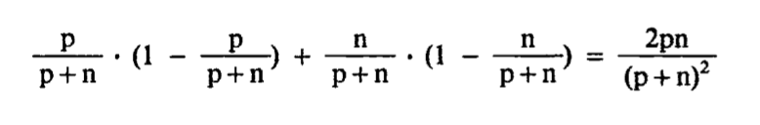
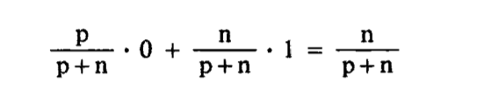
Expected Error
At very high level noise:

Slide 22

Unknown attribute values
The probability that the object has value A_{i} for attribute A can be expressed as:

Slide 23
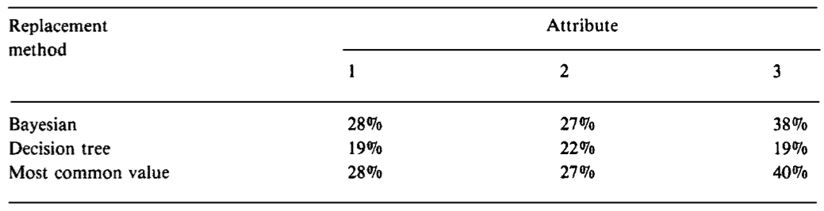

Slide 24
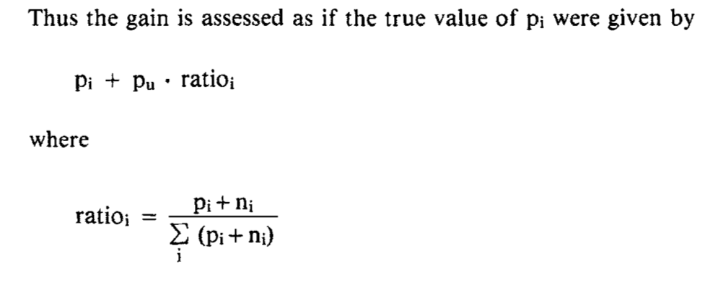

Slide 25
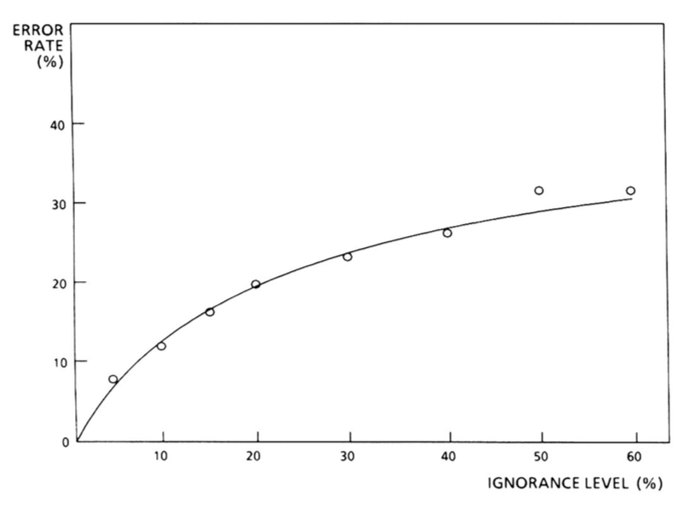

Slide 26



Selection Criterion

